Slide 1
Intelligent Web Fuzzing
Neil & Steph
Archibald venom.fuzzer@gmail.com

Slide 2
Who am i? - Neil
Neil Archibald
Security researcher (felinemenace.org)
Interested in security for around 10 years.
Mostly specialized in sysinternals / exploit development so this is quite a new topic for me.

Slide 3
Who am i? - Stephanie
Stephanie Archibald
Working in security for the past 5 years, most recently as a consultant in the Seattle area
Tend to fall into odd web / design jobs
ToorCon site / tshirts 2005 & 2006
Uninformed

Slide 4
What is fuzzing?
Fuzzing (fuzz / negative testing).
Bug finding tool.
Send random data to the inputs of a program.
Trigger bugs in the software.
Potential for security vulnerabilities.
Applied to web applications.

Slide 5
History of Web Fuzzing.
Several Web fuzzers in the past.
Rfuzz: http://rfuzz.rubyforge.org/
PowerFuzzer: http://powerfuzzer.sourceforge.net/
WSFuzzer: http://sourceforge.net/projects/wsfuzzer
HP Web Inspect: http://www.spidynamics.com/products/webinspect/index.html
Spike Proxy: http://www.immunitysec.com/resources-freesoftware.shtml
Web Scarab: http://www.owasp.org/index.php/OWASP_WebScarab_NG_Project
Burp proxy: http://www.portswigger.net/intruder/
Asp auditor: http://michaeldaw.org/projects/asp-auditor-v2/
Many more…..

Slide 6
History of Web Fuzzing: Proxies
Burp/Spike/WebScarab. Etc.
Sit between the user’s browser and the web server.
Proxy data between the two.
Allow replaying traffic, modifying it on the fly, etc.
Modules exist to fuzz the traffic in this way.
These tools are highly configurable and have a nice interface etc.
Also extensible with python, which is cool++

Slide 7
History of Web Fuzzing: Powerfuzzer
Nice GUI interface.
Based on other open source fuzzers.
Runs against a web server, rather than a proxy.
Spiders pages to fuzz.
Sends random data to pages.

Slide 8
History of Web Fuzzing: Rfuzz
Useful Ruby library.
Open source.
Allows a programmer to quickly generate random data and send it to a web server.

Slide 9
History of Web Fuzzing: Commercial
Seems SPI were bought by HP.
HP Webinspect.
Evaluation version available.
GUI.
Works much the same as PowerFuzzer.

Slide 10
History of Web Fuzzing: ASP Auditor
Perl script, run against a web server.
Looks for common configuration errors, etc.

Slide 11
History of Web Fuzzing: WSFuzzer
Useful tool from OWASP.
Tool targeting Web Services/XML.

Slide 12
Biggest Problem
Existing tools are quite useful, and do find bugs.
All these fuzzing suites have one intrinsic problem, however.
While only controlling the data between the users browser or a web client library and the server, it is difficult to notice when vulnerabilities are triggered.

Slide 13
Current bug detection methods
HTTP Response. (500, etc)
grep’ing the returned page for known errors. Database errors, ASP errors, etc.
Looking for unsanitized data echo’ed back to the web browser (for XSS).

Slide 14
Our technique…
Our technique provides a solution for this.
By controlling the machine the web server itself is running on you are able to obtain feedback from the running application.
This allows fine grain monitoring of an application to determine when a vulnerability has been triggered.

Slide 15
Venom
We code named our implementation:
V.E.N.O.M.
V irtual
E nvironment (for)
N egative-Testing,
O bservation, and
M ayhem!
(or maybe we just like comics too much)
http://code.google.com/p/venom-fuzzer/

Slide 16
Demo
Begin Demo here:
(Everyone cross your fingers)

Slide 17
How Venom works
Venom is a (Vmware) virtual machine. - Running Debian Linux
It has several components: - Proxy - Web interface - XML/RPC server - MySQL back end - Input generator / fuzzer
- Software hooks throughout the O/S

Slide 18
Venom Proxy
Ran a couple of ideas
An extensible 3rd party proxy would have been viable but not as integrated
Wanted to be able to start the vm and go!
Implemented custom proxy with python’s twisted library
Seemed to be the most common library
Zero documentation

Slide 19
Venom Proxy (cont.)
All traffic redirected through proxy
Proxy injects javascript stub
Limited to text/html content-type in learning mode
Will not inject pages containing “venomnostub”
Notifies index that the proxy is enabled
s|//venomProxyEnabled|venomProxyEnabled|
In javascript:
var venomProxyEnabled = false;
//venomProxyEnabled = true;

Slide 20
Venom Stub
Hooks the page’s onload function to store default form data
window.onload = (function() {
var ol = window.onload;
return (function() {
if(ol) ol(); // we want all processing to be complete
// before we serialize
//Enumerate all forms and store data
…
});
})();
Also hooks each form’s onsubmit function to store submitted form data
- Problematic for Web 2.0 applications

Slide 21
MySQL Backend
Pages
PID
URL
Application makes one page entry for the unmodified URL, one for the truncated URL, and one for each unmodified action URL. http://test.com?var1=1&var2 results in 2 entries:
http://test.com
http://test.com&var1=1&var2
var1 & var2 are added as elements of a GET form entry for http://test.com
<form action=“http://test.com” method=“post”>
<input type=“text” name=“cat” value=“meow”>
</form>
Adds a POST form to the already existing test.com page.
Forms
PID
FID
Method
Elements
FID
EID
Name
Values
EID
Value

Slide 22
Venom XMLRPC*
Needed a way to submit data to the database
Why XMLRPC?
Automatic data marshalling between js & python
Easy function-call-esque logic
Drawbacks
It was new to me
Couldn’t seem to call cross-domain with js’s XMLHttpRequest (Moz) or the XMLHTTP ActiveX object (IE)

Slide 23
Venom XMLRPC Client v1
You can POST cross domain….
XMLRPC traffic:
POST / HTTP/1.1
Content-Type: text/xml; charset=UTF-8
Content-Length: 92
<?xml version='1.0'?><methodCall><methodName>meow</methodName><params></params></methodCall>
Traffic of a form that POSTs an input var to the XMLRPC server:
POST / HTTP/1.1
Content-Type: application/x-www-form-urlencoded
Content-Length: 140
xml=%3C%3Fxml+version%3D%271.0%27%3F%3E%3CmethodCall%3E%3CmethodName%3Emeow%3C%2FmethodName%3E%3Cparams%3E%3C%2Fparams%3E%3C%2FmethodCall%3E

Slide 24
Venom XMLRPC Client v1 (cont.)
Turns out you can trivially implement an XMLRPC client by dynamically creating a form and submitting it in a hidden iframe…
One tweak on the server:
class venomXMLRPCServer(SimpleXMLRPCServer.SimpleXMLRPCServer):
def _marshaled_dispatch(self, data, dispatch_method = None):
if(data.startswith("xml=")):
data = unquote_plus(data[4:])
return SimpleXMLRPCServer.SimpleXMLRPCServer._marshaled_dispatch(self, data, dispatch_method)

Slide 25
Venom XMLRPC Client v1 (cont.)
function callFunction(func, args) {
var server = escape(this.server);
var port = escape(this.port);
msg =
"\<\?xml version='1.0'?\>" +
"\<methodCall\>" +
"\<methodName\>" + escape(func) + "\<\/methodName\>" +
"\<params\>" + this.serializeArgs(args) + "\<\/params\>" +
"\<\/methodCall\>";
if(this.iframeDoc && this.iframeDoc.open()) {
var formname = "venomform" + this.genID();
this.iframeDoc.write(
"<html><head></head><body><form method=\"post\"" +
"action=\"http://" + server +
"/rpc/" + port + "\" name=\"" + formname + "\"><input type=\"text\" name=\"xml\" value=\""
+ msg + "\"><input type=\"submit\"></form><script>var frm=" +
"document.forms[\"" + formname + "\"]; if(frm) {frm.submit();}<\/script>");
this.iframeDoc.close();
return true;
}
return false;
}

Slide 26
Venom XMLRPC Client v1 (cont.)
Drawback - You can’t actually retrieve server responses
Turns out the real way to solve this problem is via Apache mod_rewrite / mod_proxy
In <Directory>:
RewriteEngine On
RewriteRule ^rpc/([0-9]+)$ http://%{HTTP_HOST}:$1/ [P]
In <VirtualHost>:
<IfModule proxy_module>
ProxyRequests Off
<Proxy *>
Order deny,allow
Allow from all
</Proxy>
</IfModule>
Redirects all traffic to /rpc/<port> to <host>:<port>

Slide 27
Venom XMLRPC Client v2
Implemented custom xmlrpc client using XMLHTTPRequest / Microsoft.XMLHTTP
The few libraries looked at seemed poorly implemented
JQuery seems the best out of those tried

Slide 28
Venom XMLRPCd
Implemented with python’s SimpleXMLRPCServer
Super easy to implement:
server = SimpleXMLRPCServer.SimpleXMLRPCServer (
("", config.XMLRPC_PORT))
server.register_instance(venomXMLRPCFunctions())
server.serve_forever()
venomXMLRPCFunctions is just a class containing functions you want accessible from the web
Performs most of the interface with the SQL backend
start_fuzzing() - creates a new instance of self.fuzzerClass and starts it
Defaults to venomFuzzer; can modify

Slide 29
Venom Fuzzer
Pages
PID
URL
To determine which data to fuzz, a random selection is made from the Elements table. SELECT fid FROM Elements ORDER BY rand() LIMIT 1;
All elements associated with that FID are then selected, and filled with random element values. data = {} elements = vdb.call("getElements", (fid,))
for element in elements:
(eid, ename) = element
value = vdb.call("getRandomElementValue", (eid,))
if not value:
continue
data[ename] = unquote_plus(value[0][0])
Forms
PID
FID
Method
Elements
FID
EID
Name
Values
EID
Value

Slide 30
Venom Fuzzer
#SEND DATA
ig = self.generatorClass()
data = ig.fuzzdict(data)
data = urlencode(data)
faction = unquote_plus(faction)
if fmethod == 'get':
faction += ("?", "&")["?" in faction]
faction += data
data = None
if self.__xmlrpc:
self.__xmlrpc.new_session(
self.__appID, faction, data, fmethod
)
urllib2.urlopen(faction, data)

Slide 31
Input generator
Our input generator is very simple.
You can swap it out with your own if you desire.
Different to binary input generators as you’re not trying to trigger buffer overflows/length problems.
Created a list of data which could create potential problems that would be noticeable by our hooks.

Slide 32
Input Generator continued…
Examples are: - %00
- <? !@ ?>
- ../../ - |
Specifically designed to trigger hooks in certain situations.

Slide 33
Input Generator Algorithm
def fuzzinput(self,input):
if not input:
input = self.geninput()
newinput = input
for n in range(0,random.randint(1,2)):
fuzzno = random.randint(0,len(newinput)-1)
newinput = newinput[0:fuzzno] + self.geninput() + newinput[fuzzno:]
# end for
return newinput
# end fuzzinput

Slide 34
Input Generator Algorithm
def geninput(self):
n = 0;
data = "";
for n in range(0,random.randint(1,self.__no_tries)):
offset = random.randint(0,len(self.fuzzcases)-1);
data += self.fuzzcases[offset];
# end for
return data;
# end geninput

Slide 35
Hooking
Our hooking system needs to intercept program flow in order to inspect data and determine if a vulnerability has been triggered.
Constraints:
- Uses a minimum of library calls.
- Works regardless of context.
- Remain language inspecific.
- Save a blob of appropriate data.
Could have used a heuristic approach to the hooks, however couldn’t justify spending that much time on this project.

Slide 36
Hooking… Implemented
Simple python script which accesses the MySQL backend.
Takes information from the command line.
Queries the XML/RPC server to determine if data should be logged and determine the session ID.
Only requires fork()/execve() system calls to execute.

Slide 37
Hooking… Implemented
Macro:
#ifndef VENOMHOOK___
#define VENOM_DOLOGEVENT(type, data) /* update db */ \
char *__venom__cmd = NULL; \
asprintf(&__venom__cmd, "/var/venom/bin/venomdb.py %d \"%s\" \"%s\"\r\n",getpid(),type,data); \
if(__venom__cmd != (char *)-1) { \
system(__venom__cmd); \
free(__venom__cmd); \
}
#define VENOMHOOK__
#endif
VENOM_DOLOGEVENT("HEAP OVERFLOW",data);

Slide 38
Regrets…
At first we planned to have EVERYTHING hooked for this talk.
PHP/Perl/Python/Bash/Kernel/Mysql/ Postgresql/ /dev/kitchensink.
Too ambitious on the deadline mentioned.
Instead we stuck to just PHP, MySQL and bash for now.
☹

Slide 39
Hooking PHP
Types of PHP bugs:
- Eval() bugs (php code execution).
- Filesystem bugs (directory traversal,
etc)
- Command injection
(exec(),passthru(), etc)
- Remote include.
- Register globals.

Slide 40
Eval() bugs.
PHP uses Zend engine.
Zend/ directory in src.
zend.c contains vital zend API functions.
When an error occurs in Zend code the zend_error() function is called.
This usually indicates a parse error in php code.
By inserting our hooks here we intercept the error process and can log an event.

Slide 41
Eval() bugs continued…
ZEND_API void zend_error(int type, const char *format, ...)
{
..stuff..
char *__venom__msg = NULL;
switch(type) {
case E_PARSE:
if(strstr(error_filename,": eval()'d code")){
asprintf(&__venom__msg, "php runtime error in file: %s line: %i\n
VENOM_DOLOGEVENT("PHPEVALERROR",__venom__msg);
break;
}
asprintf(&__venom__msg, "php runtime error in file: %s line: %i\n", error
VENOM_DOLOGEVENT("PHPPARSEERROR",__venom__msg);
break;
}
/* if we don't have a user defined error handler */
if (!EG(user_error_handler)
|| !(EG(user_error_handler_error_reporting) & type)) {
zend_error_cb(type, error_filename, error_lineno, format, args);
..stuff..
}

Slide 42
Eval() bugs continued.
This hook will catch conditions where eval() code fails to parse.
This indicates we may have injected some bad characters into the input while fuzzing.
This may mean that php injection is possible.
Also preg_replace() with the /e modified works like eval().
Since we hook the zend engine itself, conditions like this will be caught.

Slide 43
File system bugs
Most of the core functions in php are implemented in the ext/ directory.
ext/standard contains file access code.
Examples of some of these functions are:
file() and file_get_contents() and readfile().
Can grep for actual php functions by searching for the #define: PHP_FUNCTION().

Slide 44
File system bugs continued…
In order to detect file system bugs, we created hooks which check for the following conditions:
- One of these file functions failing to
access a file. (May indicate input
tampering.)
- One of these file functions accessing a
file which does not begin with
/var/www (our webroot). (May indicate
directory traversal, etc).

Slide 45
File system bugs continued…
First hook is in main/streams/streams.c
Covers all the stream based functions. File() getfilecontents() etc
PHPAPI php_stream *_php_stream_open_wrapper_ex(char *path, char *mode, int options,
char **opened_path, php_stream_context *context STREAMS_DC TSRMLS_DC)
{
php_stream *stream = NULL;
php_stream_wrapper *wrapper = NULL;
char *path_to_open;
int persistent = options & STREAM_OPEN_PERSISTENT;
char *copy_of_path = NULL;
#ifndef VENOMHOOK___
#define VENOM_DOLOGEVENT(type, data) /* update db */ \
char *__venom__cmd = NULL; \
asprintf(&__venom__cmd, "/var/venom/bin/venomdb.py %d \"%s\" \"%s\"\r\n",getpid(),type,data);
if(__venom__cmd != (char *)-1) { \
system(__venom__cmd); \
free(__venom__cmd); \
}
#define VENOMHOOK__
#endif
char *__venom__realpath = realpath(path,NULL);
if(__venom__realpath != NULL) {
#define VENOMWEBROOT "/var/www/"
if(strncmp(__venom__realpath,VENOMWEBROOT,strlen(VENOMWEBROOT)) &&
strncmp(__venom__realpath,"./",2)
)
{
VENOM_DOLOGEVENT("PHPFILEOUTSIDEWEBROOT",__venom__realpath);
free(__venom__realpath);
}
}

Slide 46
File system bugs continued…
Also added hooks to each of the file related functions individually.
These check for that the file exists.
PHP_FUNCTION(file_get_contents)
{
stream = php_stream_open_wrapper_ex(filename, "rb",
(use_include_path ? USE_PATH : 0) | ENFORCE_SAFE_MODE | REPORT_ERRORS,
NULL, context);
if (!stream) {
#ifndef VENOMHOOK___
#define VENOM_DOLOGEVENT(type, data) /* update db */ \
char *__venom__cmd = NULL; \
asprintf(&__venom__cmd, "/var/venom/bin/venomdb.py %d \"%s\" \"%s\"\r\n",getpid(),type,data); \
if(__venom__cmd != (char *)-1) { \
system(__venom__cmd); \
free(__venom__cmd); \
}
#define VENOMHOOK__
#endif
VENOM_DOLOGEVENT("PHPFILEMISSING",filename);

Slide 47
File system bugs continued…
Again due to time constraints, I have yet to hook chmod(),chown(),copy() and other file operations.
Hopefully in the future I will address this...

Slide 48
Command Injection
Most of the command exec functions utilize bash.
A few cases don’t and need covered individually.
Hooking bash provides coverage for other languages.

Slide 49
Command Injection: Hooking bash.
Hooking bash was quite trivial.
Required 2 hooks.
execute_cmd.c
error.c
Changed the shell for everyone in /etc/passwd.
root:x:0:0:root:/root:/bin/oldbash
venom:x:1000:1000:venom,,,:/home/venom:/bin/oldbash
#

Slide 50
Command Injection: Hooking bash
execute_cmd.c
if (command == 0)
{
#ifndef VENOMHOOK___
#define VENOM_DOLOGEVENT(type, data) /* update db */ \
char *__venom__cmd = NULL; \
asprintf(&__venom__cmd, "/var/venom/bin/venomdb.py %d \"%s\" \"%s\"\r\n",getpid(),type,data); \
if(__venom__cmd != -1) { \
system(__venom__cmd); \
free(__venom__cmd); \
}
#define VENOMHOOK__
#endif
char *__venom_msg = NULL;
asprintf(&__venom_msg,"%s: command not found",pathname);
VENOM_DOLOGEVENT("BASHCMDEXEC",__venom_msg);
free(__venom_msg);
internal_error (_("%s: command not found"), pathname);
exit (EX_NOTFOUND); /* Posix.2 says the exit status is 127 */
}

Slide 51
Command Injection: Hooking bash
In error.c:
void
#if defined (PREFER_STDARG)
parser_error (int lineno, const char *format, ...)
#else
parser_error (lineno, format, va_alist)
int lineno;
const char *format;
va_dcl
#endif
{
#ifndef VENOMHOOK___
#define VENOM_DOLOGEVENT(type, data) /* update db */ \
char *__venom__cmd = NULL; \
asprintf(&__venom__cmd, "/var/venom/bin/venomdb.py %d \"%s\" \"%s\"\r\n",getpid(),type,data); \
if(__venom__cmd != -1) { \
system(__venom__cmd); \
free(__venom__cmd); \
}
#define VENOMHOOK__
#endif
va_list args;
char *ename, *iname;
ename = get_name_for_error ();
iname = yy_input_name ();
char *__venom_msg = NULL;
asprintf (&__venom_msg, "%s: %s:%s%d: ", ename, iname, gnu_error_format ? "" : " line ", lineno);
VENOM_DOLOGEVENT("BASHCMDEXEC",__venom_msg);
free(__venom_msg);

Slide 52
Command Injection
Some side cases not covered by this.
We need to manually hook the side cases which error out before the command is passed to bash.
An example is in ext/standard/exec.c
An empty command will pass through, therefore:
static void php_exec_ex(INTERNAL_FUNCTION_PARAMETERS, int mode)
{
#ifndef VENOMHOOK___
#define VENOM_DOLOGEVENT(type, data) /* update db */ \
...
#define VENOMHOOK__
#endif
...
if (!cmd_len) {
VENOM_DOLOGEVENT("PHPCMDEXEC","Attempt to execute a blank command.");

Slide 53
Remote Includes
main/main.c
static void php_message_handler_for_zend(long message, void *data)
{
TSRMLS_FETCH();
switch (message) {
case ZMSG_FAILED_INCLUDE_FOPEN:
php_error_docref("function.include" TSRMLS_CC, E_WARNING, "Failed opening '%s' for inclusion (include_path='%s')", php_strip_url_passwd((char *) data), STR_PRINT(PG(include_path)));
break;
case ZMSG_FAILED_REQUIRE_FOPEN:
php_error_docref("function.require" TSRMLS_CC, E_COMPILE_ERROR, "Failed opening required '%s' (include_path='%s')", php_strip_url_passwd((char *) data), STR_PRINT(PG(include_path)));
break;
case ZMSG_FAILED_HIGHLIGHT_FOPEN:
php_error_docref(NULL TSRMLS_CC, E_WARNING, "Failed opening '%s' for highlighting", php_strip_url_passwd((char *) data));
break;

Slide 54
Remote Includes continued…
static void php_message_handler_for_zend(long message, void *data)
{
#ifndef VENOMHOOK___
#define VENOM_DOLOGEVENT(type, data) /* update db */ \
char *__venom__cmd = NULL; \
asprintf(&__venom__cmd, "/var/venom/bin/venomdb.py %d \"%s\" \"%s\"\r\n",getpid(),type,data); \
if(__venom__cmd != (char *)-1) { \
system(__venom__cmd); \
free(__venom__cmd); \
}
#define VENOMHOOK__
#endif
TSRMLS_FETCH();
switch (message) {
case ZMSG_FAILED_INCLUDE_FOPEN:
case ZMSG_FAILED_REQUIRE_FOPEN:
if(!strncmp(data,"http",4)) {
VENOM_DOLOGEVENT("PHPREMOTEINCLUDEFAIL",data);
} else {
VENOM_DOLOGEVENT("PHPINCLUDEFAIL",data);
}
break;
}

Slide 55
Register Globals
We can easily parse the config file to check if register_globals has been set during the installation of each application. We also need to parse .htaccess in the working directory of the application.
If register_globals is enabled, we simply provide a warning during the reporting phase.

Slide 56
Hooking MySQL
PAINFUL to configure.
Required 2 MySQL instances running on separate ports. Using two different binaries.
Debian MySQL scripts are crazily overcomplicated and silly.

Slide 57
Hooking MySQL
The only thing we really want to look for is SQL injection.
Basically knowing about a failed SQL statement being executed should indicate this.
MySQL source is confusing ☹
libmysqld/ vs sql/ etc.
http://forge.mysql.com/wiki/MySQL_Internals_Files_In_MySQL_Sources

Slide 58
Hooking MySQL Continued..
sql/sql_parse.cc
void mysql_parse(THD *thd, const char *inBuf, uint length,const char ** found_semicolon)
{
...
if (! thd->net.report_error)
{
...
else
{
...
#ifndef VENOMHOOK___
#define VENOM_DOLOGEVENT(type, data) /* update db */ \
char *__venom__cmd = NULL; \
asprintf(&__venom__cmd, "/var/venom/bin/venomdb.py %d \"%s\" \"%s\"\r\n",getpid(),type,data); \
if(__venom__cmd != (char *)-1) { \
system(__venom__cmd); \
free(__venom__cmd); \
}
#define VENOMHOOK__
#endif
VENOM_DOLOGEVENT("MYSQLPARSEERROR“,inBuf);

Slide 59
Reporting
Each VENOM_DOLOGEVENT() call provides a unique type identifier.
Correlated in reporting table in the database to pull description.

Slide 60
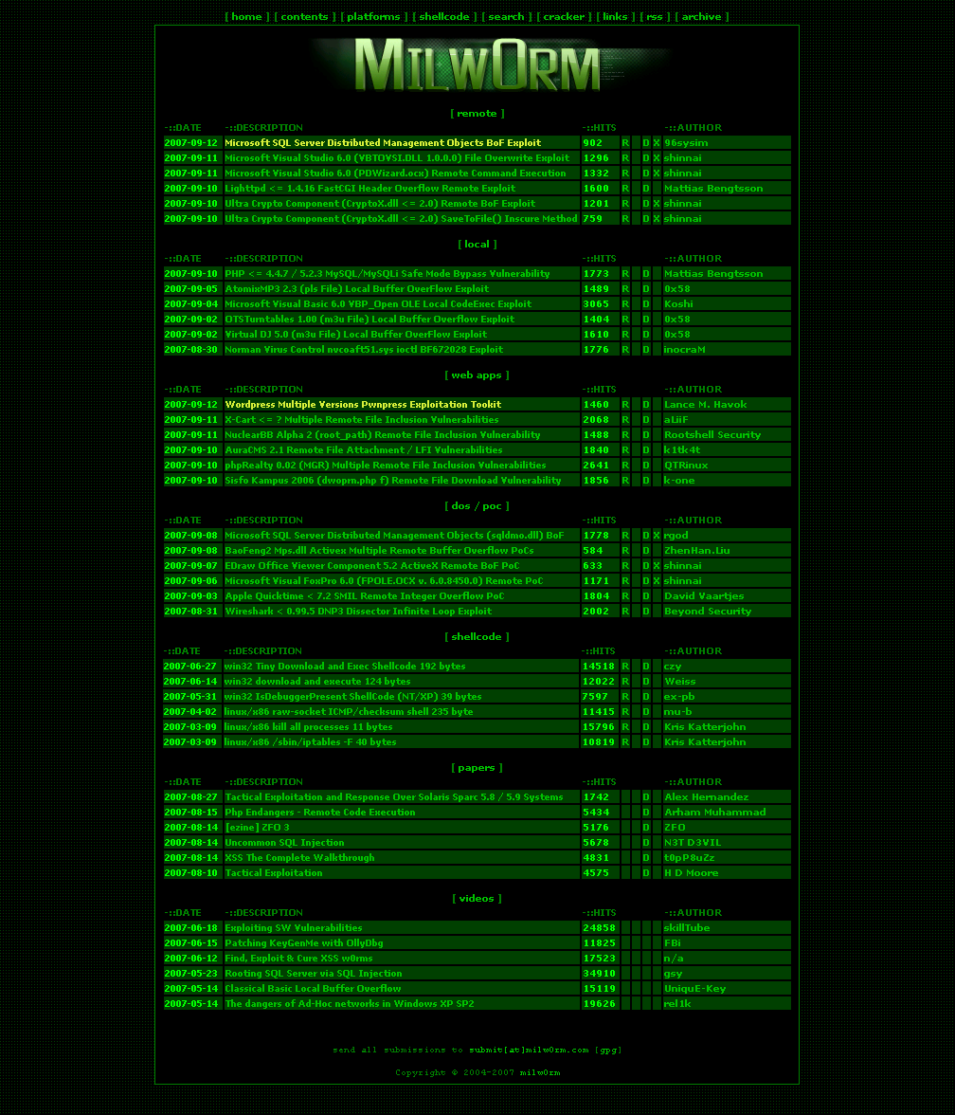
Reporting continued…
We also generate a python script to send the data to the server. This can easily be modded into an exploit once the vulnerability is understood clearly.
We simply insert the data into a python template.
Our code utilizes urllib2.

Slide 61
Limitations
- May not be web 2.0 compatible. - Can only fuzz one application at a
time.
- Ignores XSS - PHP/MySQL/bash hooked at the
moment.
- Session handling - Can only fuzz applications which you have the source for, you must be able
to upload it.

Slide 62
Wish List
Wish List
Better reporting
Currently flooded with the same error
SimpleXMLRPCServer respond size limitation
RPC fuzzing capabilities
Including web 2.0 / xmlrpc / json traffic
Cookie handling
Sequential Fuzzing

Slide 63
Questions?
Any questions?
If you want to discuss anything come see us at the bar after the talk!

